Slide 1
06. Exercise: A dynamic user interface
In this exercise, you are going to program your first dynamic user interface. You will have the following elements:
a paragraph of text which should be empty when the page is first opened
a textbox
a button
When the button is clicked, the paragraph of text will display what is currently in the textbox.
Hint: Depending on your Browser settings, it might happen that the JavaScript and CSS files get cached. This means, that upon opening the page again the "cached" and thus previous version of your JavaScript and CSS files get applied. In this case, please try what's called a hard refresh. Depending on your operating system there is a key combination for that. For instance, on Windows hold down Ctrl and click the reload button, on Mac OS hold down ⇧ Shift and click the reload button.
Of course, should you have any question or problem, reach out to us by using the Q&A section below or by booking a one-on-one meeting!

Slide 2
15.08 Exercise: Add elements to your web page
Take the page you had to create in the previous exercise and add the following HTML to it:
another button
a second text box
When the user clicks on the new button, it should add the content of the second textbox between the textbox and the elements you did set in the previous exercise. These new paragraphs should also implement a style class.
In the next video, I will go through this briefly one more time but if you have any issue completing this exercise, reach out for help… …and don't forget to push your code to GitHub!
Good luck!

Slide 3
11. Exercise: Get rid of these!
It should come as no surprise but in this exercise, I want you to add one more button to your page… …and when the button is clicked, you will need to remove the last paragraph that was created as long as there are paragraphs (yes, the last and not the first like in the previous video!)
Don't forget to push your code to GitHub and in the next lesson, I will walk you through my solution!
Good luck!

Slide 4

15.14. Exercise: A persistent item list

Slide 5
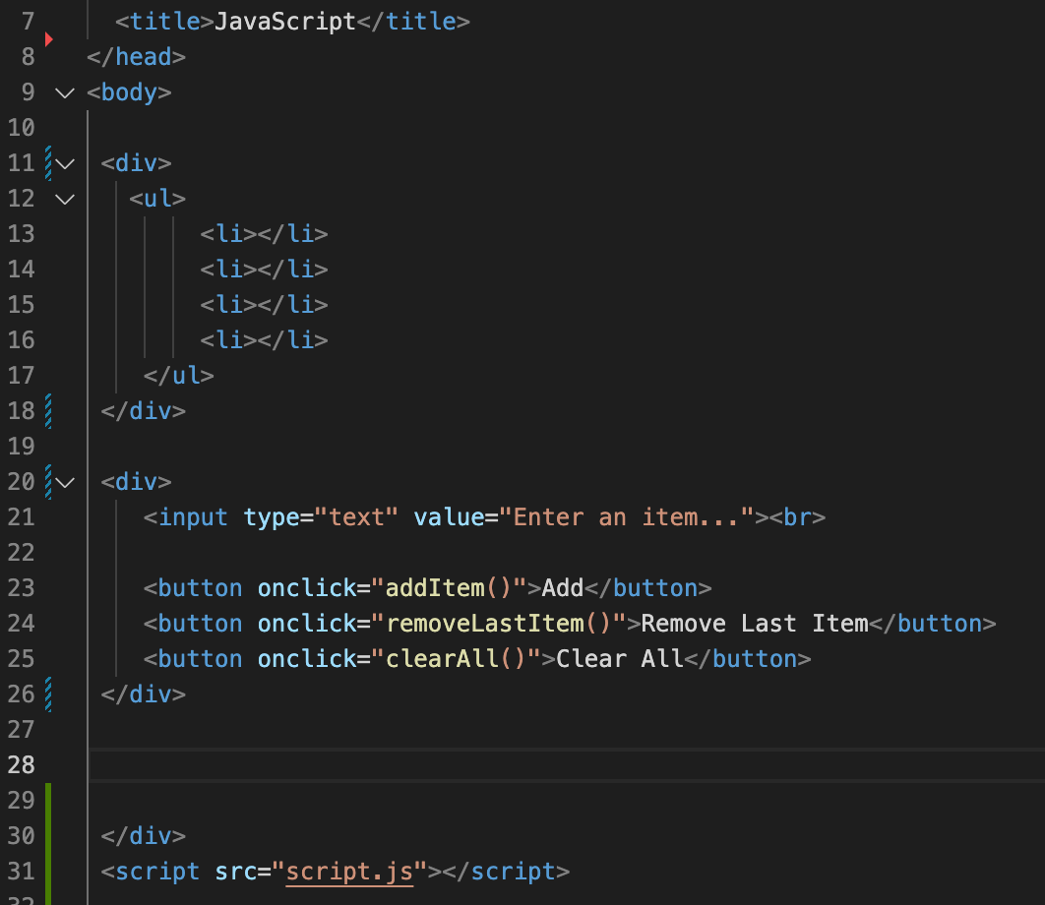

Slide 6
